Slide 1

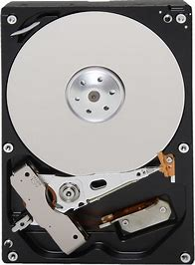
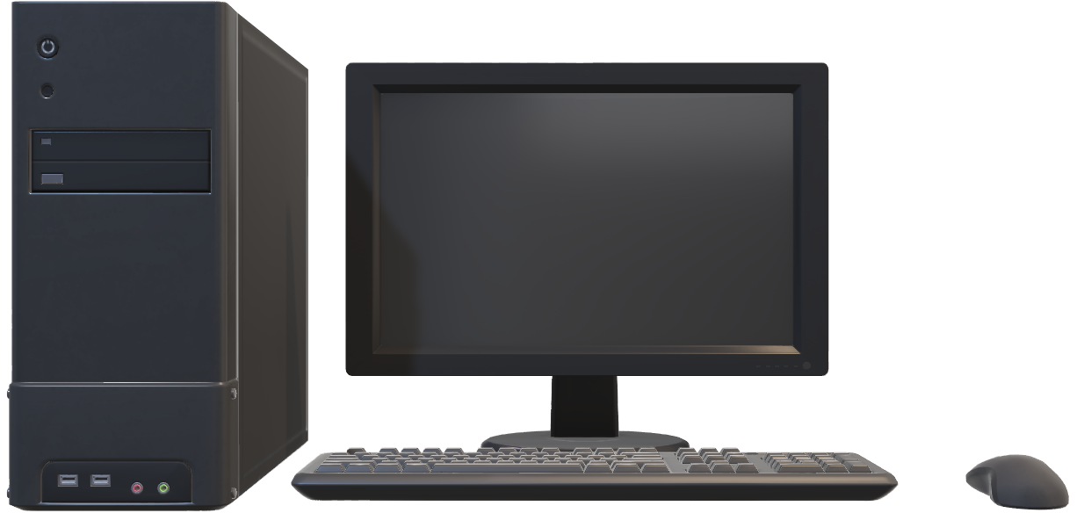
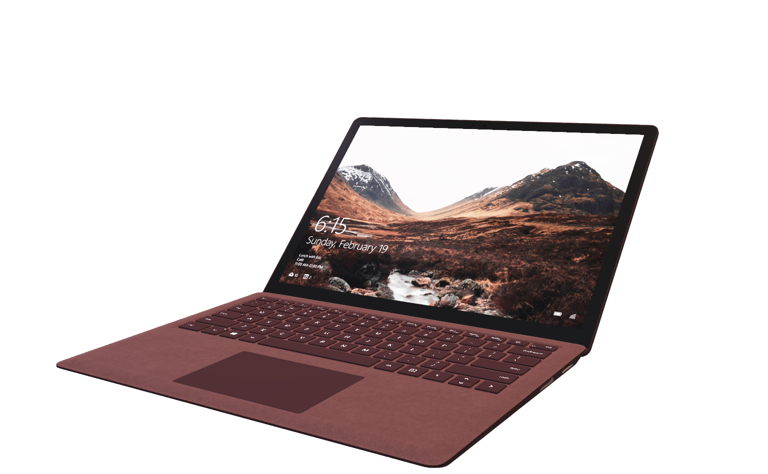
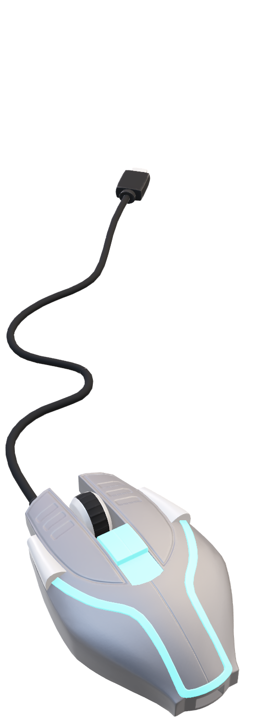
Atliq Hardwares | Consumer Goods Insights
- Presented by Girish-E

Slide 2
Problem Statement
Atliq Hardwares (imaginary company) is one of the leading computer hardware producers in India and well expanded in other countries too.
However, the management noticed that they do not get enough insights to make quick and smart data-informed decisions. They want to expand their data analytics team by adding several junior data analysts. Tony Sharma, their data analytics director wanted to hire someone who is good at both tech and soft skills. Hence, he decided to conduct a SQL challenge which will help him understand both the skills.
Tasks
1) There are 10 ad-hoc requests for which the business needs insights. We have to execute SQL queries to answer these requests.
2) Presentation creation is visualize the business insights using Excel/Power BI/Tableau.

Slide 3
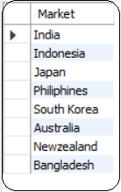
Markets for customer “Atliq Exclusive” in APAC region
Question : Provide the list of markets in which customer "Atliq Exclusive" operates its business in the APAC region.
Output

Slide 4
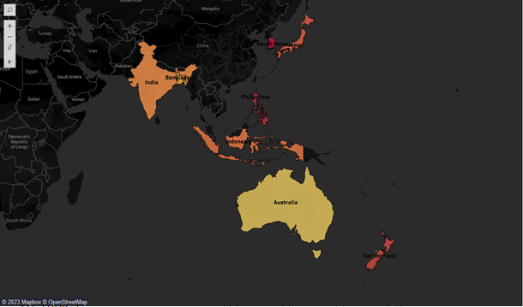
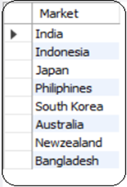
Conversion of output to visual
Insights
In APAC region, customer “Atliq Exclusive” has spread its business not only in India but also in Indonesia, Japan, Philippines, South Korea, Australia, New Zealand and Bangladesh.

Slide 5
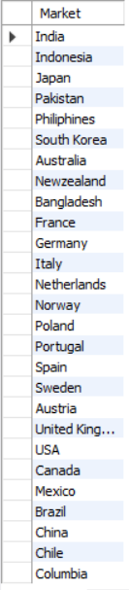
Atliq Hardwares Markets
Question : Provide the list of markets Atliq Hardwares
operates its business all over the world.
Output

Slide 6
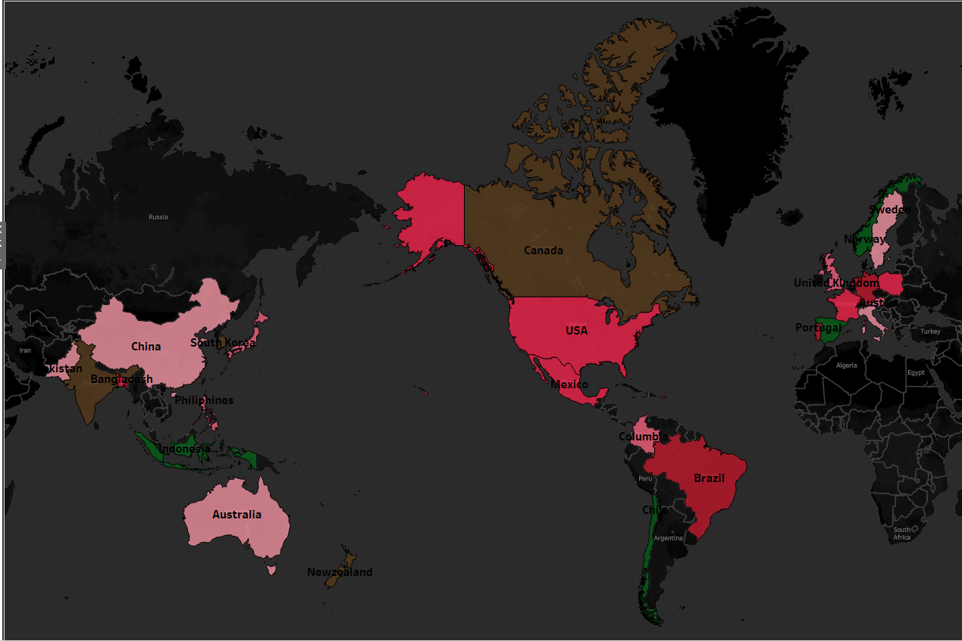
Conversion of output to visual
Insights
Atliq Hardwares has spread its business in 27 countries around the world.

Slide 7
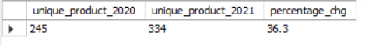
Yearly Unique Product increase
Question : What is the percentage of unique product increase in 2021 vs. 2020? The final output contains these fields : unique_products_2020 unique_products_2021 percentage_chg
Output

Slide 8
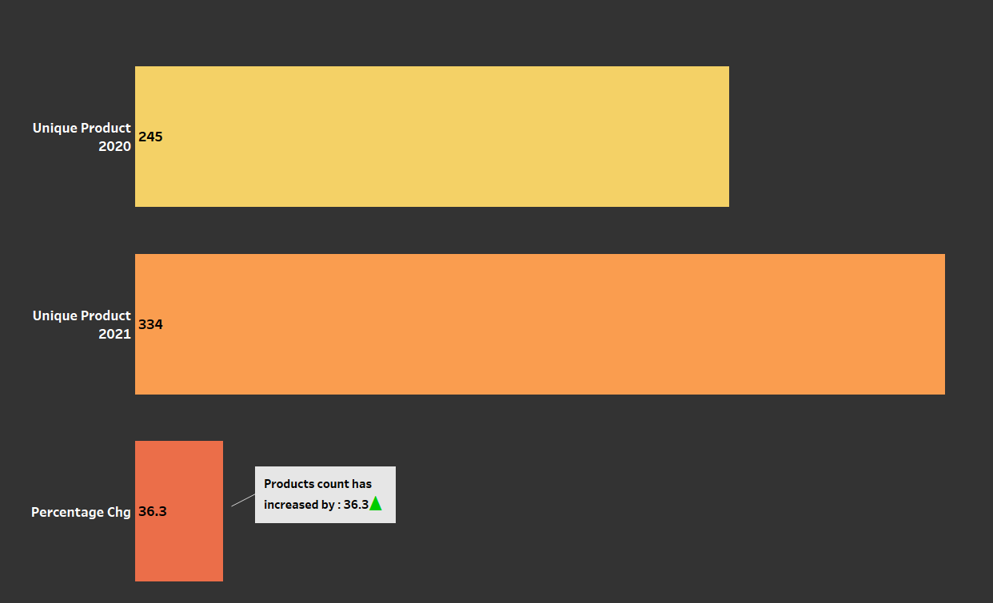
Conversion of output to visual
Insights
Results show that Atliq Hardwares are competitive in introducing new products.
They have focussed on generating the revenue by increasing the on-demand products by 36.3%.

Slide 9
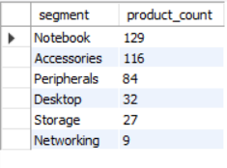
Product count segment-wise
Question : Provide a report with all the unique product counts for each segment and sort them in descending order of product counts. The final output contains 2 fields,
segment
product_count
Output

Slide 10
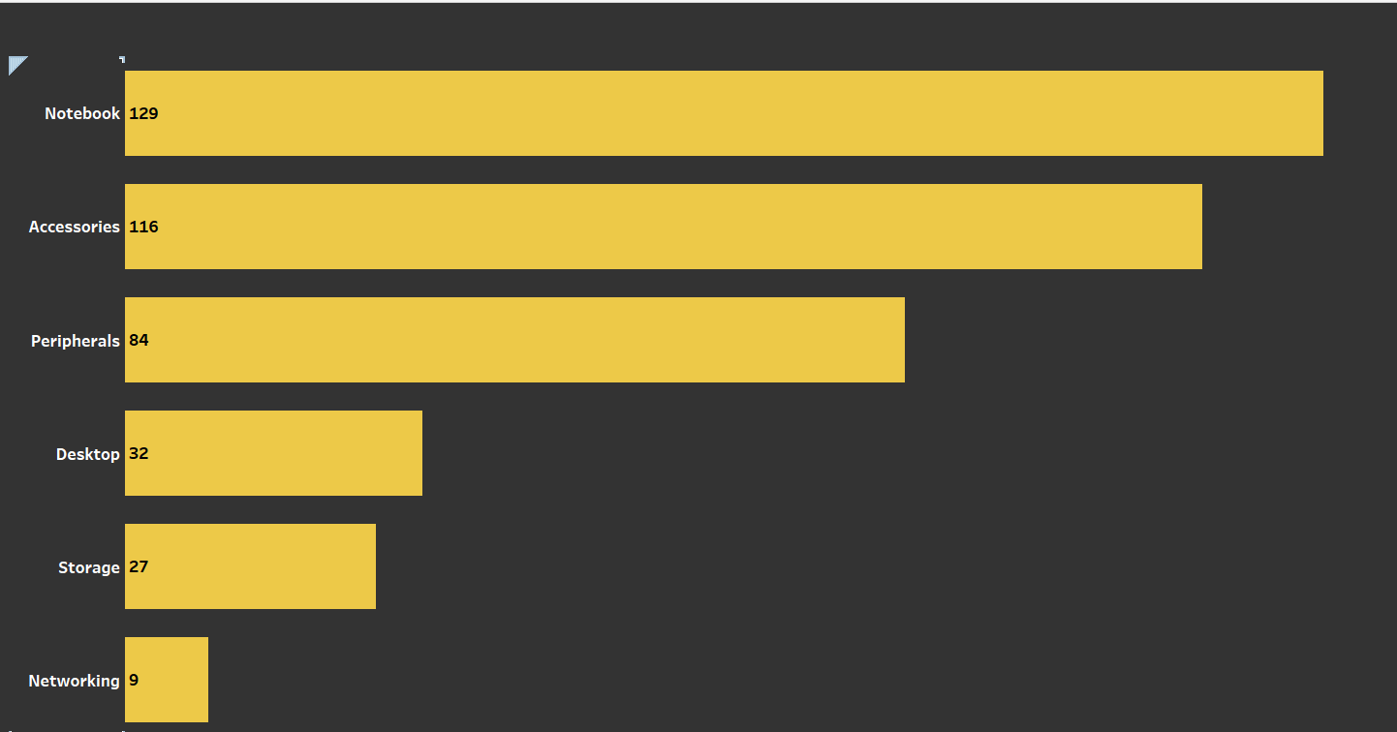
Conversion of output to visual
Insights
Results show that there are maximum products in Notebook as compared to other segments.

Slide 11
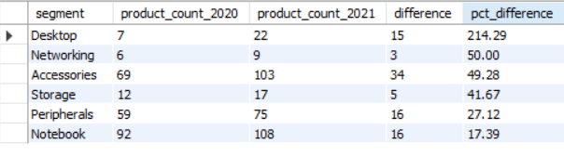
Yearly Product count segment-wise
Question : Follow-up: Which segment had the most increase in unique products in 2021 vs 2020? The final output contains these fields,
segment
product_count_2020
product_count_2021
difference
Output

Slide 12
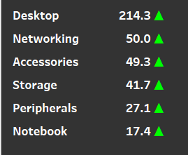
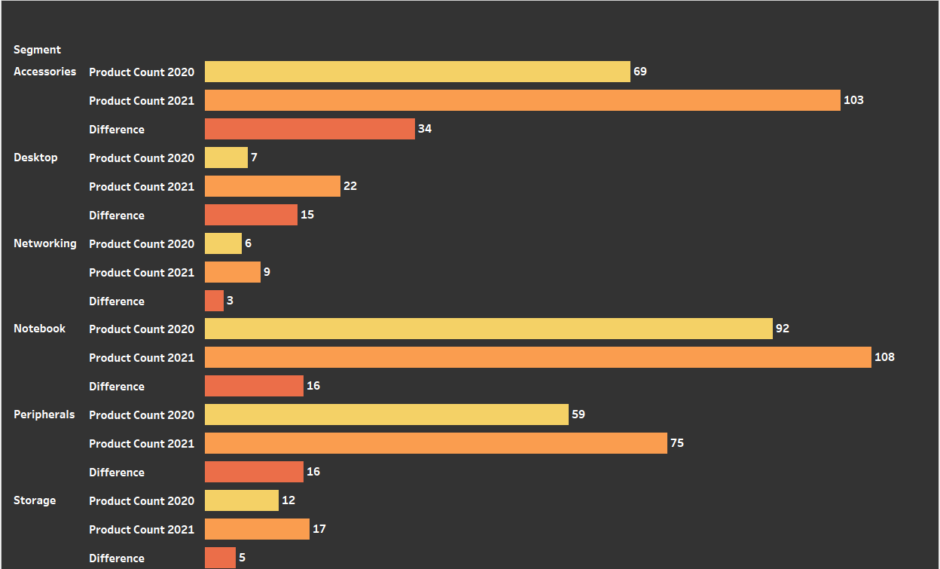
Conversion of output to visual
Insights
Results show that Atliq Hardwares have introduced new in-demand products in every segment. However, Desktop records 214.29 % increase as compared to other segments.

Slide 13
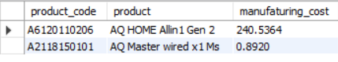
Highest and Lowest Manufacturing costs
Question : Get the products that have the highest and lowest manufacturing costs. The final output should contain these fields,
product_code
product
manufacturing_cost
Output

Slide 14
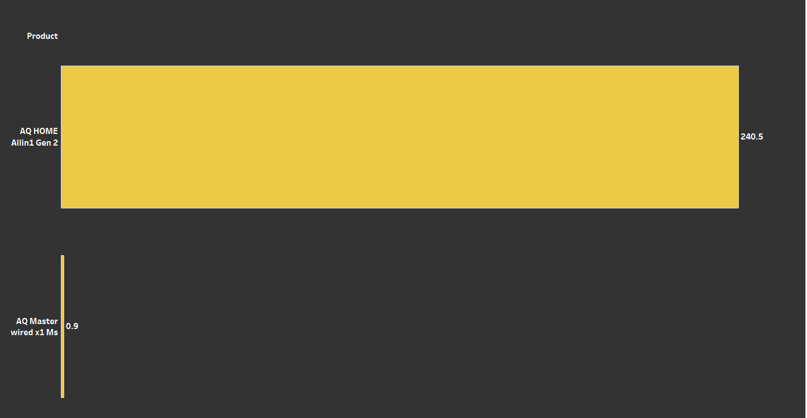
Conversion of output to visual
Insights
Results show that Product # AQ HOME Allin 1 Gen 2(Personal Desktop) has maximum manufacturing cost and Product # AQ Master wired x 1 Ms(Mouse) has minimum manufacturing cost.

Slide 15
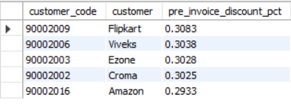
Top 5 customers in Indian Market
Question : Generate a report which contains the top 5 customers who received an average high pre_invoice_discount_pct for the fiscal year 2021 and in the Indian market. The final output contains these fields,
customer_code
customer
average_discount_percentage
Output

Slide 16
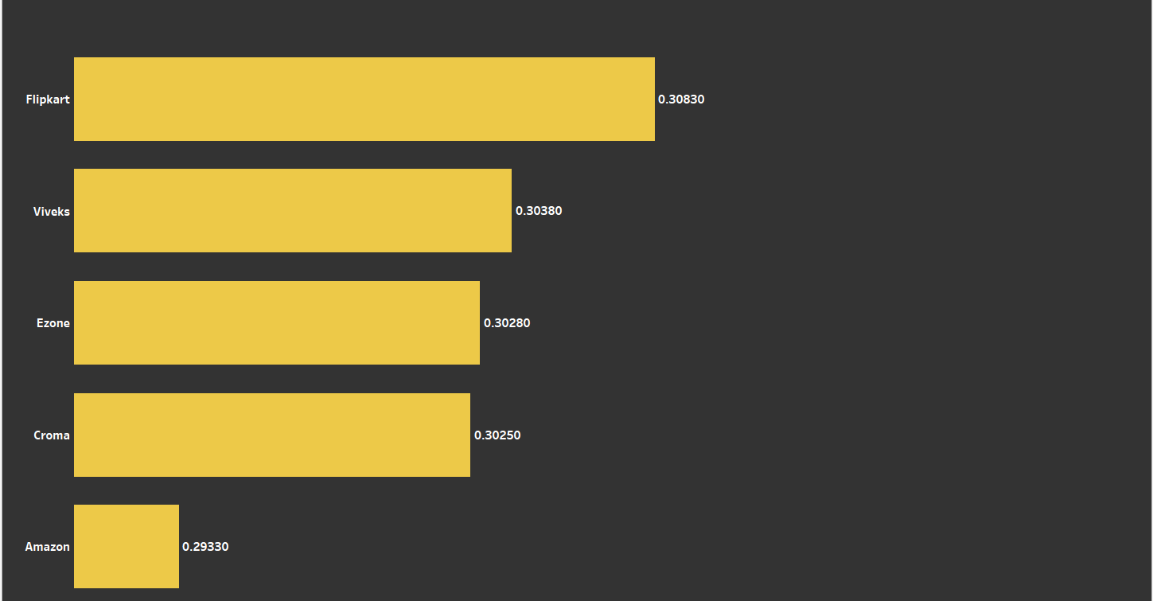
Conversion of output to visual
Insights
Results show that Flipkart tops the Indian customer market of Atliq Hardwares with 0.3083% discount.

Slide 17
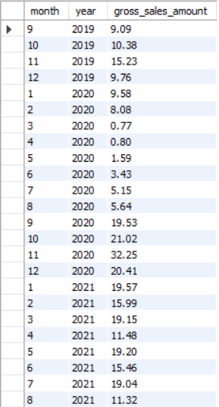
Gross Sales Trend for Atliq Exclusive over 3 years: 2019, 2020 and 2021
Question : Get the complete report of the Gross sales amount for the customer “Atliq Exclusive” for each month . This analysis helps to get an idea of low and high-performing months and take strategic decisions. The final report contains these columns:
Month
Year
Gross sales Amount
Output

Slide 18
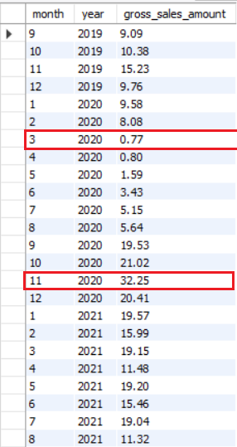
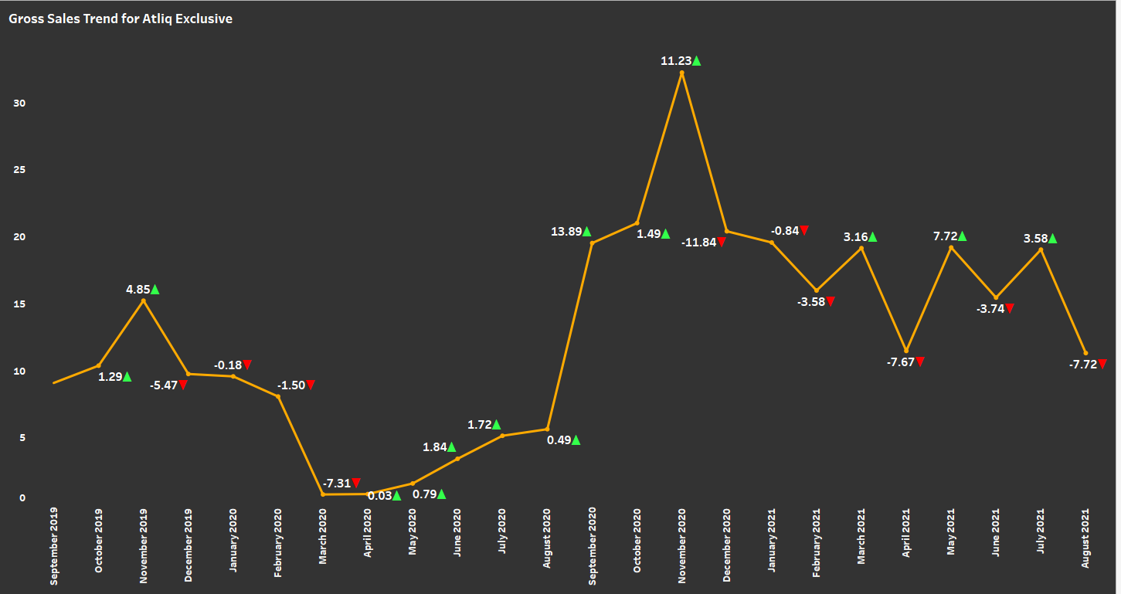
Conversion of output to visual
Insights
Results show that November 2020 has been high-performing month for Atliq Exclusive with Gross Sales amount being 32.25 Millions and low-performing month is March 2020 with Gross Sales amount being 0.77 Millions.
We can also infer from the graphs that Gross Sales shows upward trend towards end of each year and downward trend during start of the year

Slide 19
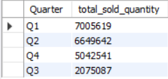
Total Sold Quantity Quarter-wise for year 2020
Question :
In which quarter of 2020, got the maximum total_sold_quantity? The final output contains these fields sorted by the total_sold_quantity,
Quarter
total_sold_quantity
Output

Slide 20
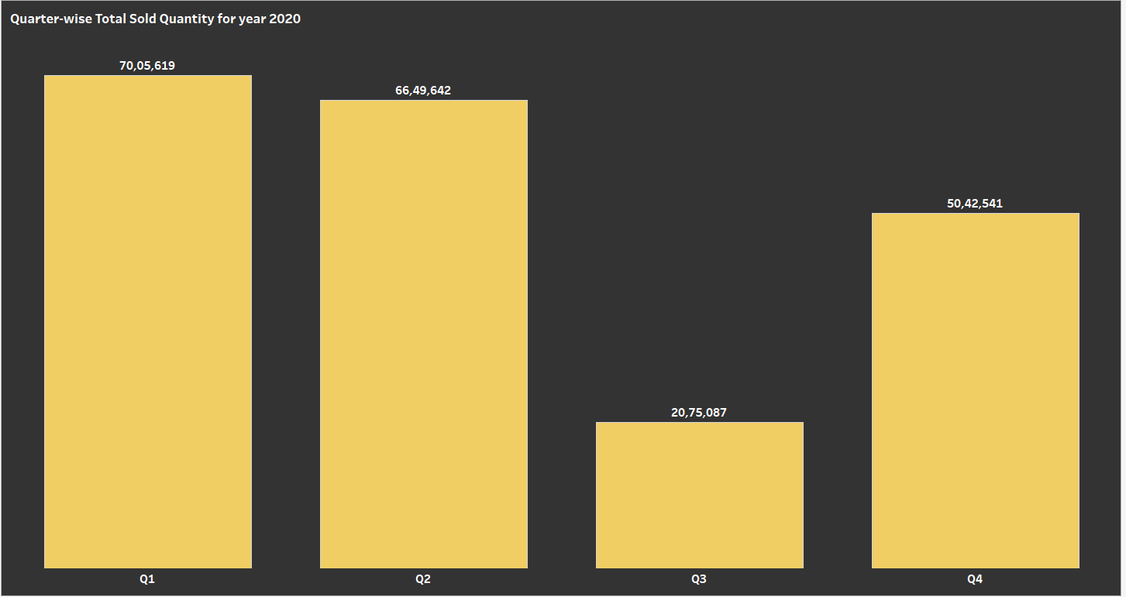
Conversion of output to visual
Insights
Results show that 7005619 units were sold in fourth quarter of year 2020, making it the maximum among the quarters.

Slide 21
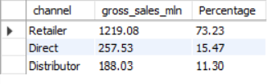
Channel wise contribution towards Gross Sales for fiscal year 2021
Question : Which channel helped to bring more gross sales in the fiscal year 2021 and the percentage of contribution? The final output contains these fields,
channel
gross_sales_mln
percentage
Output

Slide 22
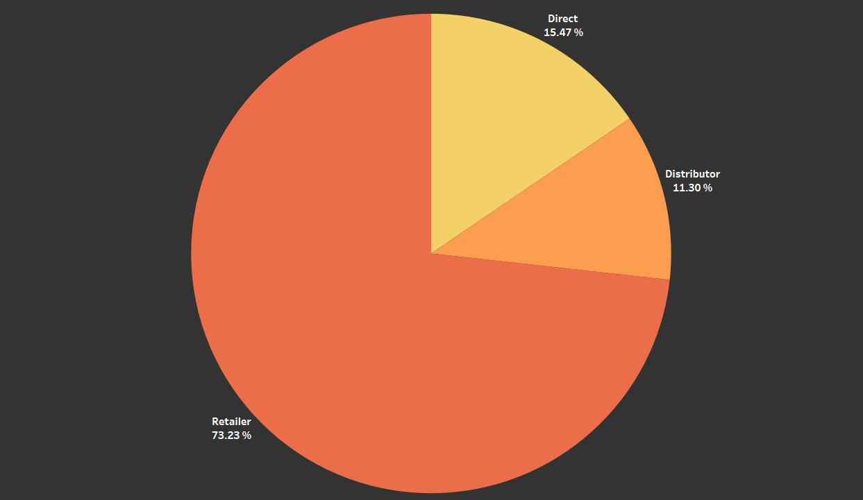
Conversion of output to visual
Insights
Pie chart shows that Retailer had contributed 73.23 % to bring more sales to Atliq Hardwares in fiscal year 2021

Slide 23
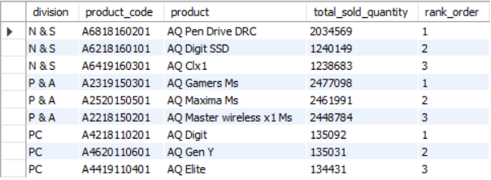
Top 3 products division-wise with high total sold quantity in fiscal year 2021
Question :
Get the Top 3 products in each division that have a high total_sold_quantity in the fiscal_year 2021? The final output contains these fields,
division
product_code
Output

Slide 24
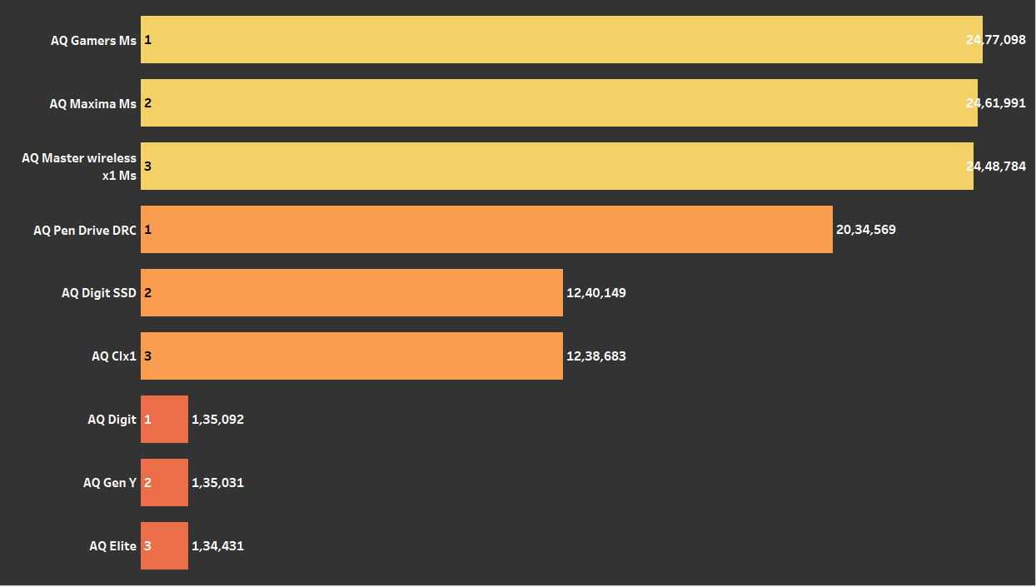

Conversion of output to visual
Insights
AQ Pen Drive DRC(Category: USB Flash Drives) in N & S, AQ Gamers Ms (Category: Mouse) in P & A and AQ Digit (Category: Personal Laptop) in PC division tops the maximum sold quantity in fiscal year 2021

Slide 25
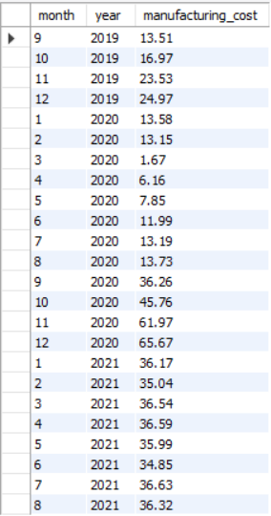
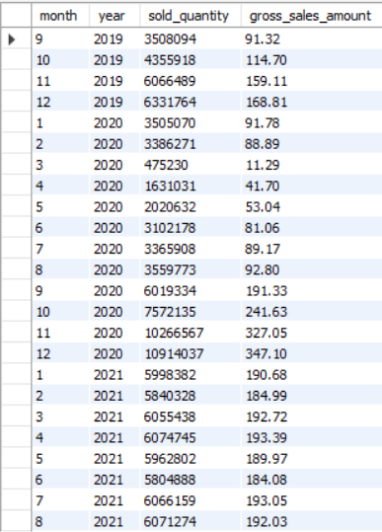
Total Gross Sales/Quantity Sold/Manufacturing Cost for Atliq Hardwares over 3 years: 2019, 2020 and 2021
Question : Get the Total Gross Sales/Quantity Sold/Manufacturing Cost by Year
Output

Slide 26
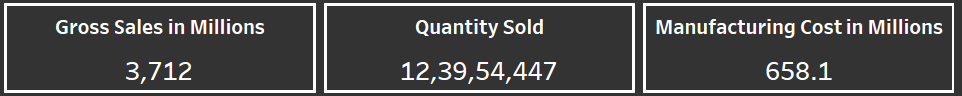
Conversion of output to visual
Insights
Visualization shows Total value of Gross Sales, Quantity Sold and Manufacturing Cost

Slide 27
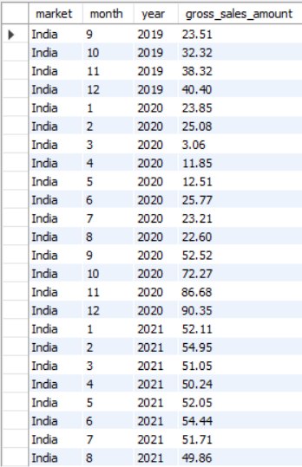
Total Gross Sales for Atliq Hardwares by Market
Question : Get the Total Gross Sales by Market
Output

Slide 28
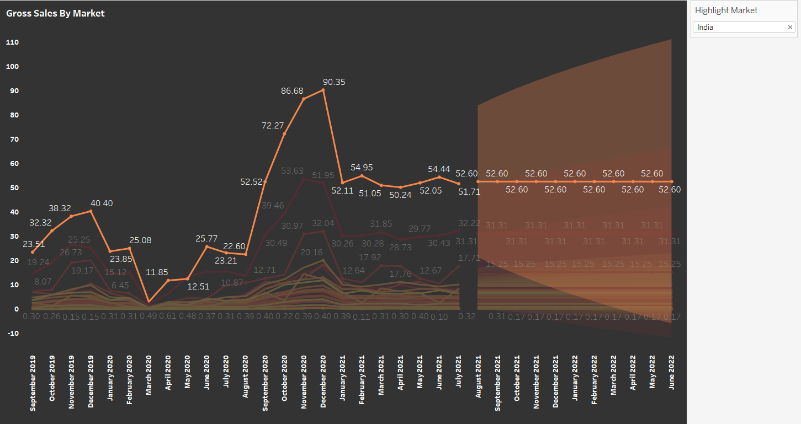
Conversion of output to visual
Insights
India market has generated more revenue as compared to other markets. Also we can see Gross Sales shows upward trend towards end of the year and downward trend towards start of the year.
Note: For ease of visualization, only India market has been shown on the slide

Slide 29
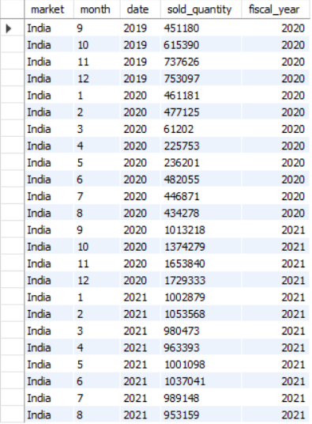
Sold Quantity Trend for Atliq Hardwares Market Wise
Question : Get the Sold Quantity by Market
Output

Slide 30
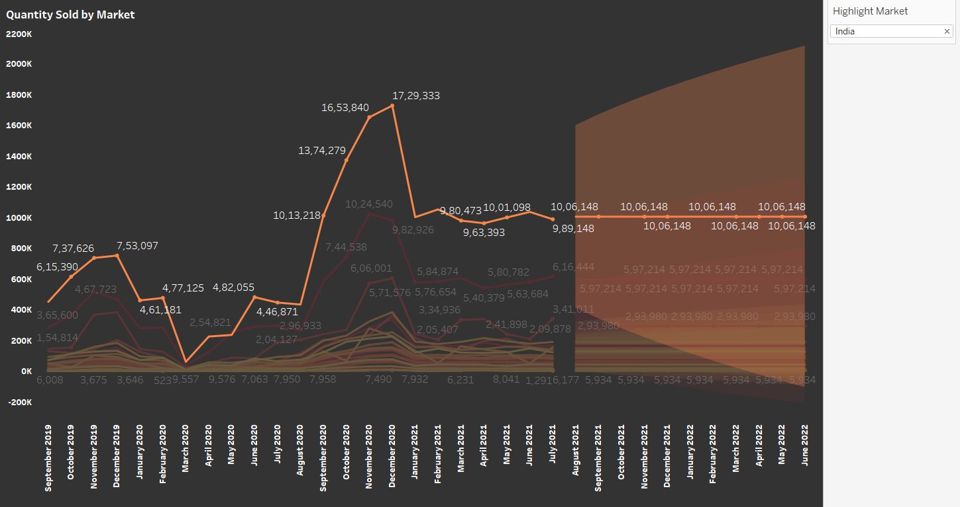
Conversion of output to visual
Insights
India market has generated more revenue by selling more units as compared to other markets. Also we can see that more units are sold towards end of the year and comparatively less units towards start of the year.
Note: For ease of visualization, only India market has been shown on the slide

Slide 31
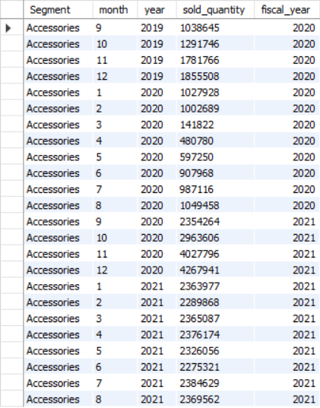
Sold Quantity Trend for Atliq Hardwares Segment Wise
Question : Get the Sold Quantity by Segment
Output

Slide 32
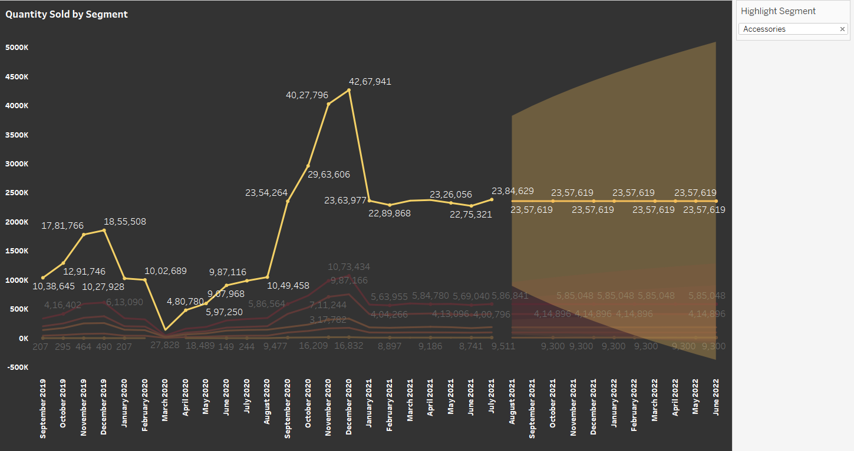
Conversion of output to visual
Insights
Accessories segment has sold more units as compared to other segments. Also we can see that more units are sold in December months as compared to other months.
Note: For ease of visualization, only Accessories segment has been shown on the slide

Slide 33
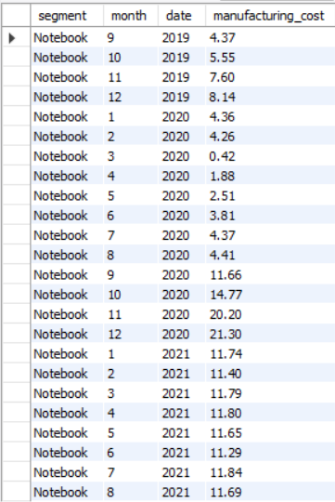
Manufacturing Cost Trend for Atliq Hardwares Segment Wise
Question : Get the Manufacturing Cost by Segment
Output

Slide 34
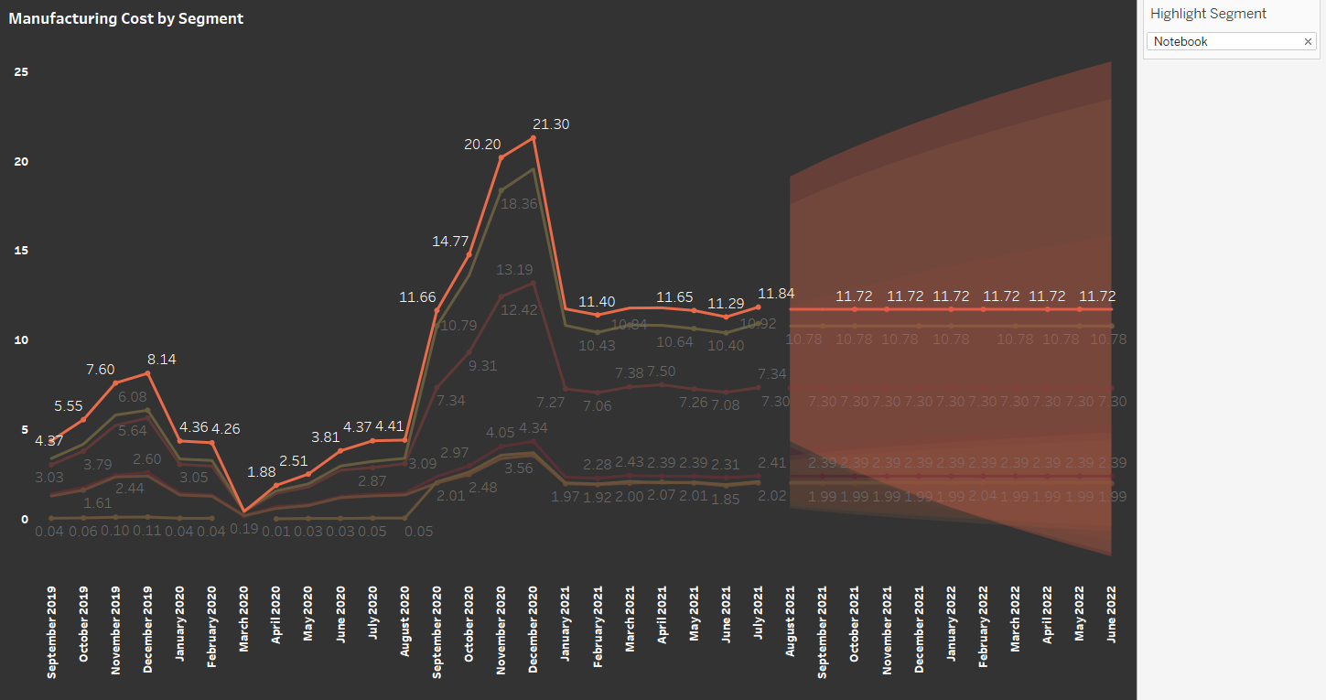
Conversion of output to visual
Insights
More cost is incurred to manufacture units of Notebook as compared to other segments. Also we can see that costs increases towards end of the year and decreases towards start of the year.
Note: For ease of visualization, only Notebook segment has been shown on the slide

Slide 35
Thank You

